Slide 1
Characterizing PFAS in California’s Drinking Water, Groundwater, and Wastewater
April 27, 2022 │CASA – Ask the Experts
Wendy Linck, PG, PMP
Division of Water Quality
Divisions of Drinking Water and Water Quality

Slide 2
Perspective on the PFAS Class
~40
~1,200
USEPA Analytical Methods
Non-Target Analysis (NTA)
~4,700
OECD Global PFAS Database
~6,300
USEPA PFAS Master Description
USEPA PFAS Master List
~10,000
April 2022
2

Slide 3
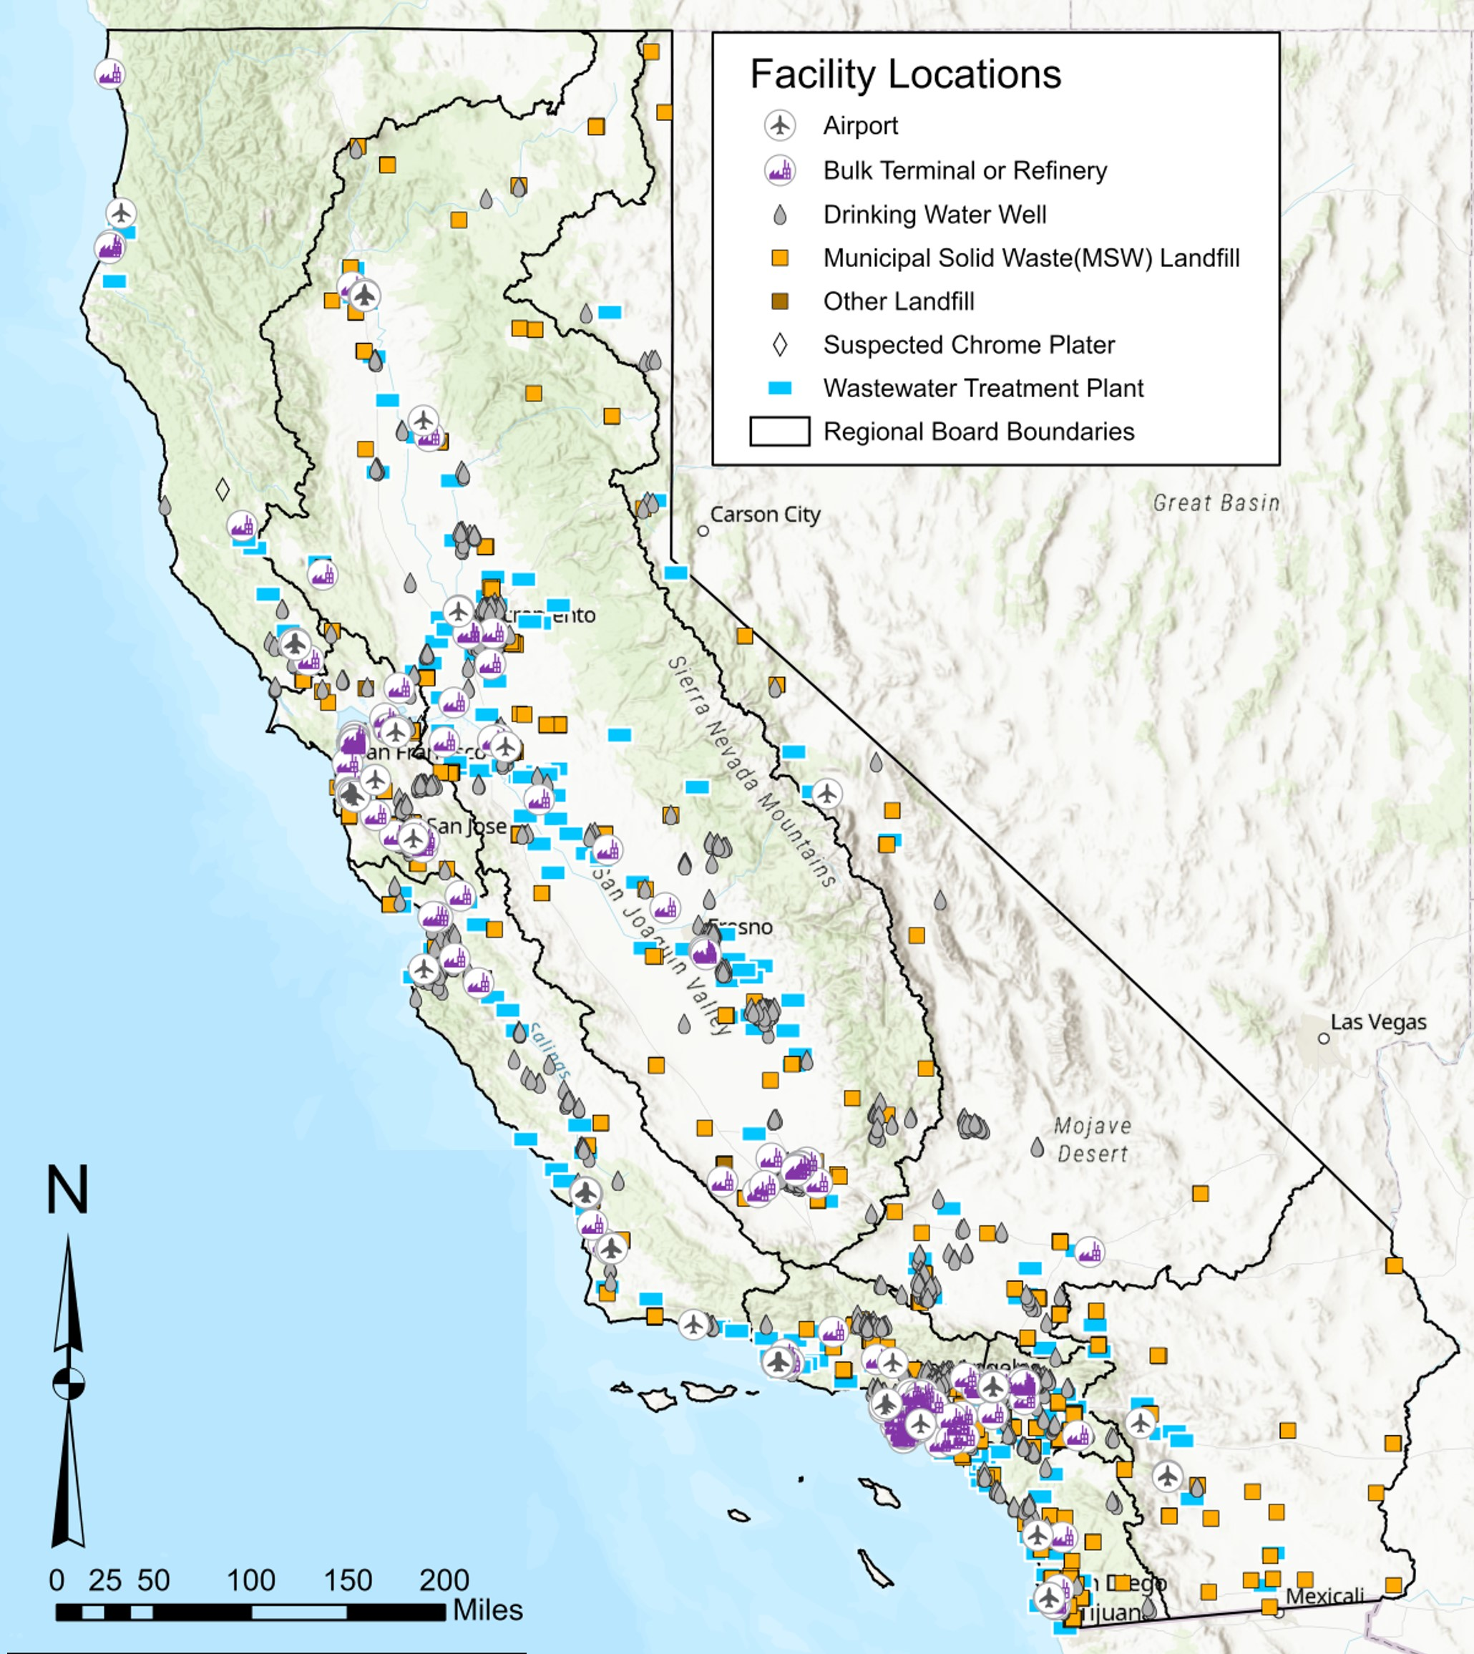
Occurrence of PFAS at Industries is Being Gathered State-Wide
April 2022
3

Slide 4
Over 50% of the Industrial Sources in Wastewater are Potential Sources of PFAS
Number of WWTPs BY Influent Flow source
April 2022
4

Slide 5
State-wide Industry Investigative Orders has provided vital information but there are gaps
Media | Chrome Platers | Airports | Landfills | POTWs | Bulk Fuel Terminals/ Refineries
Soil |  |  |  | * Includes biosolids
Groundwater
Stormwater
Surface Water/ Sediment
Wastewater |  |  | * Includes leachate
To be assessed | Not Detected to Low Concentrations (<100 ppt) | Moderate Concentrations (100 ppt to 5,000 ppt) | Significant Concentrations (>5,000 ppt)
All matrices were analyzed using the DoD QSM with 25 to 38 analytes.
April 2022
5

Slide 6
Median Concentrations in Industry Investigation Samples are less than 100 ng/L except Landfill Leachate
April 2022
6

Slide 7
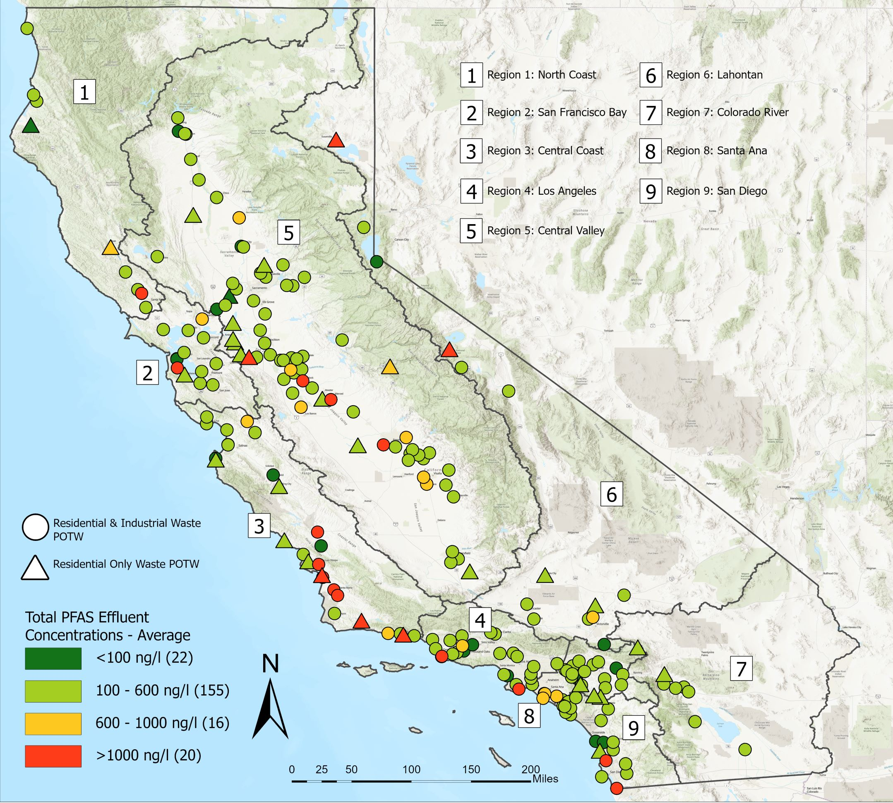
PFAS is in Wastewater
Data downloaded in February 2022
Samples analyzed using the DoD QSM (38 analytes)
April 2022
7

Slide 8
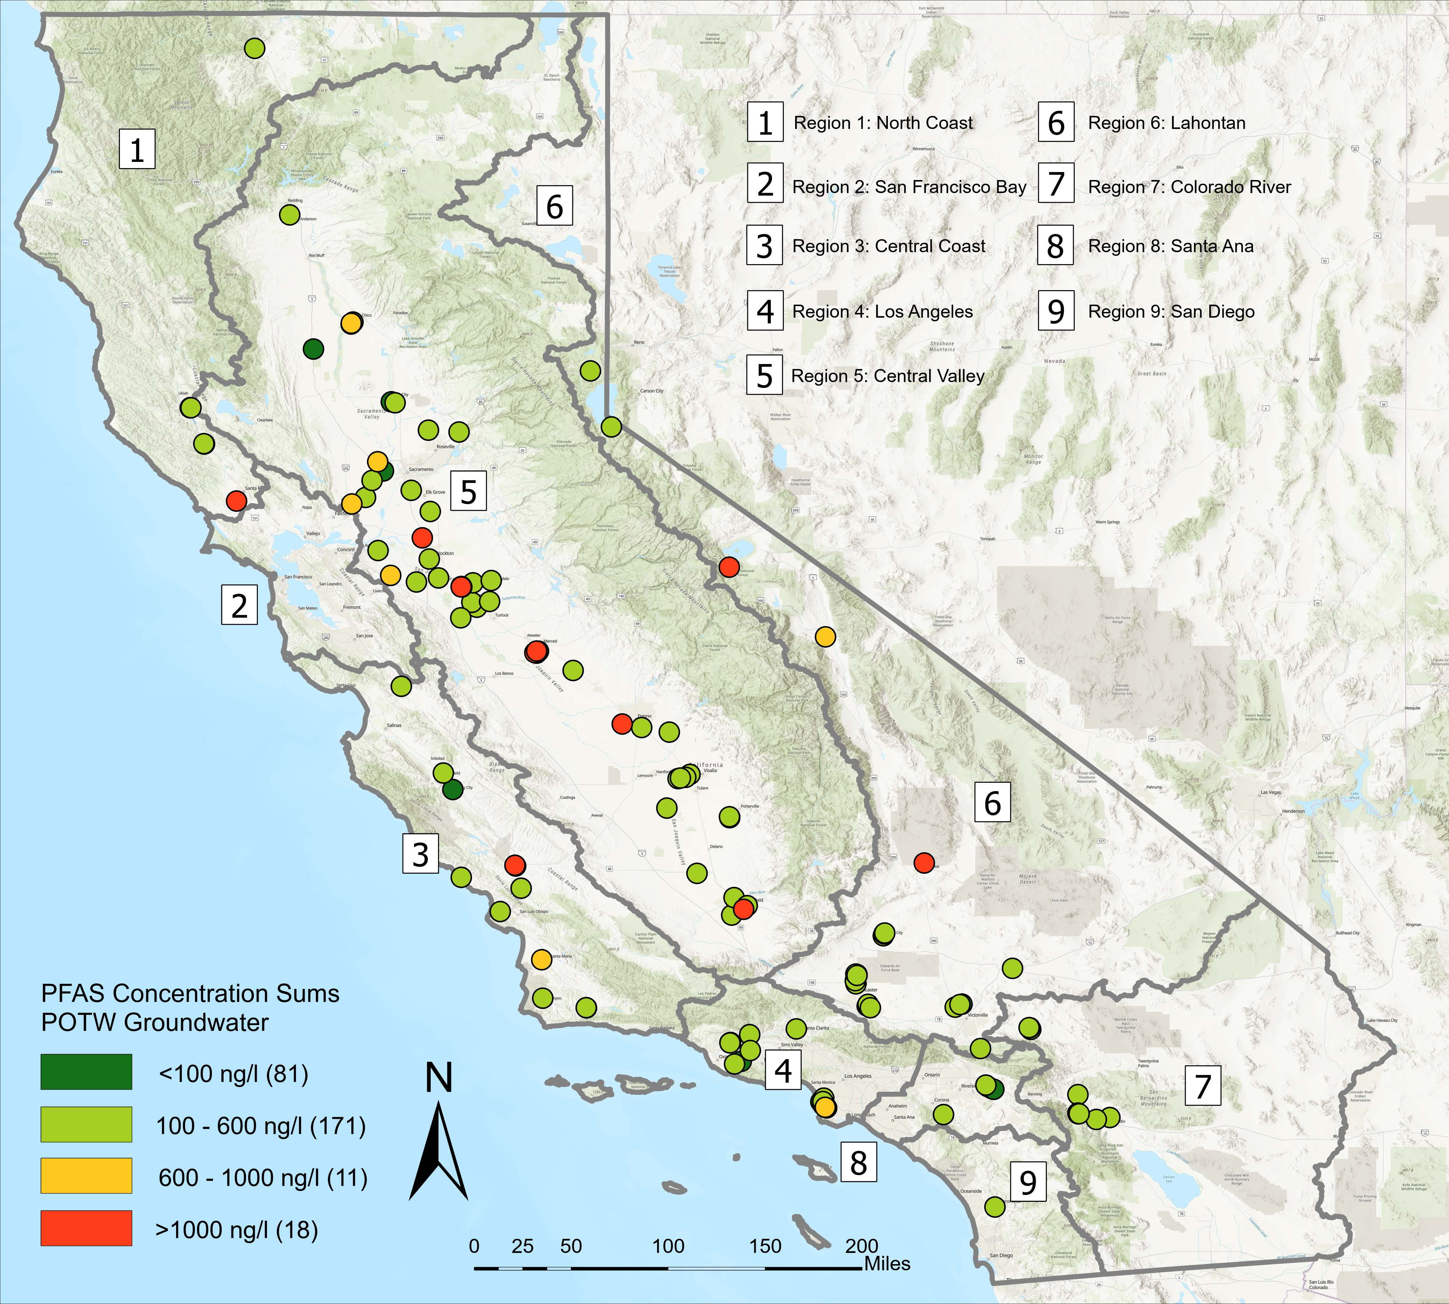
PFAS is in Groundwater at POTWs
Data downloaded in February 2022 – Airports, Landfills, Chrome Platers, WWTPS, and GAMA - Priority Basin Project
Total PFAS sums based on DoD QSM (25 to 38 analytes)
Pollution Burden Percentiles from CalEnviroScreen V4.0
April 2022
8

Slide 9
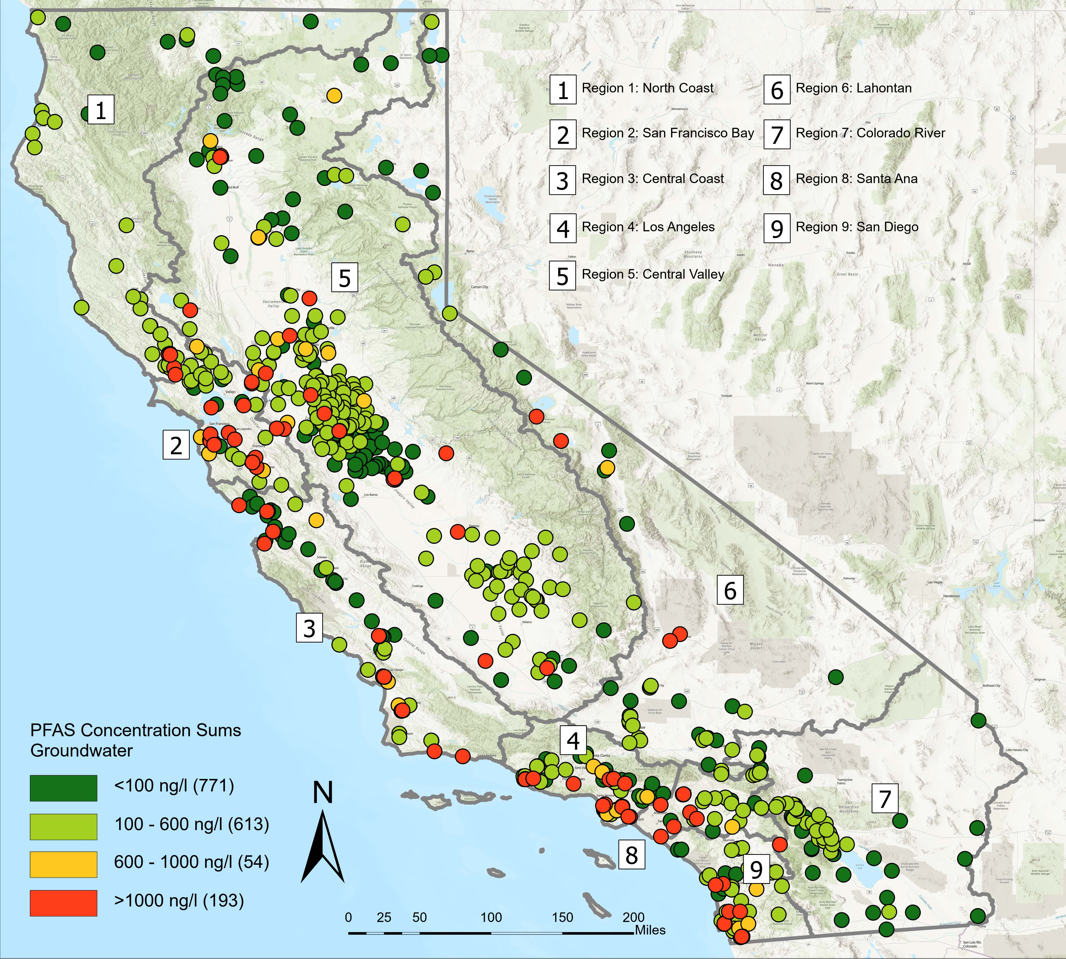
PFAS is in Groundwater - Statewide
Data downloaded in February 2022 – Airports, Landfills, Chrome Platers, WWTPS, and GAMA - Priority Basin Project
Total PFAS sums based on DoD QSM (25 to 38 analytes)
Pollution Burden Percentiles from CalEnviroScreen V4.0
April 2022
9

Slide 10
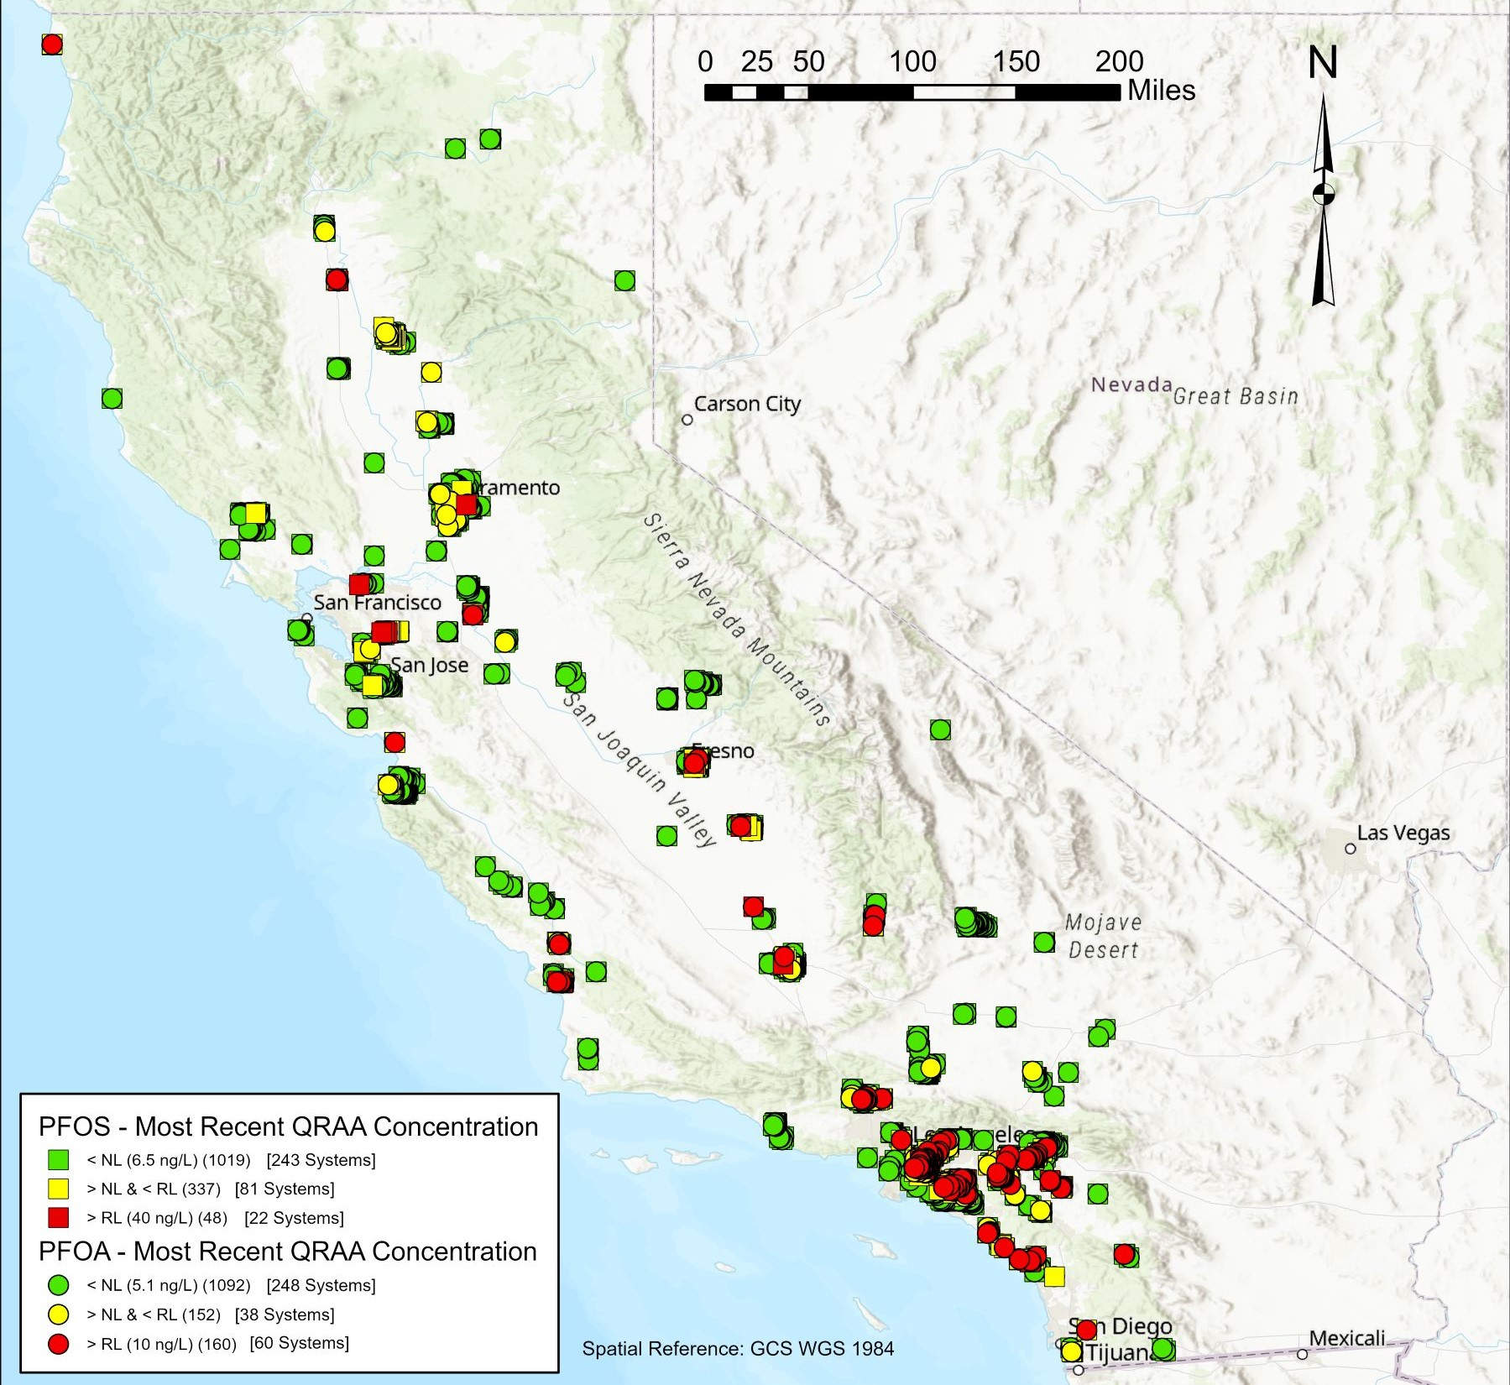
Drinking Water Supply Wells - PFOA/PFOS Notification Level /Response Level Exceedances
Data downloaded in February 2022 – raw water results
NL = Notification Level; QRAA = Quarterly Running Annual Average
RL = Response Level
PFOA and PFOS analyzed using EPA Method 537.1
PFOA: = NL = 5.1 ng/L, RL = 10 ng/L │PFOS: NL = 6.5 ng/L, RL = 40 ng/L
April 2022
10

Slide 11
Shift Drinking Water Method to Match Source Data
April 2022
11

Slide 12
Estimates of Total Organofluorine in Drinking Water Reveals Interesting Results
April 2022
12

Slide 13
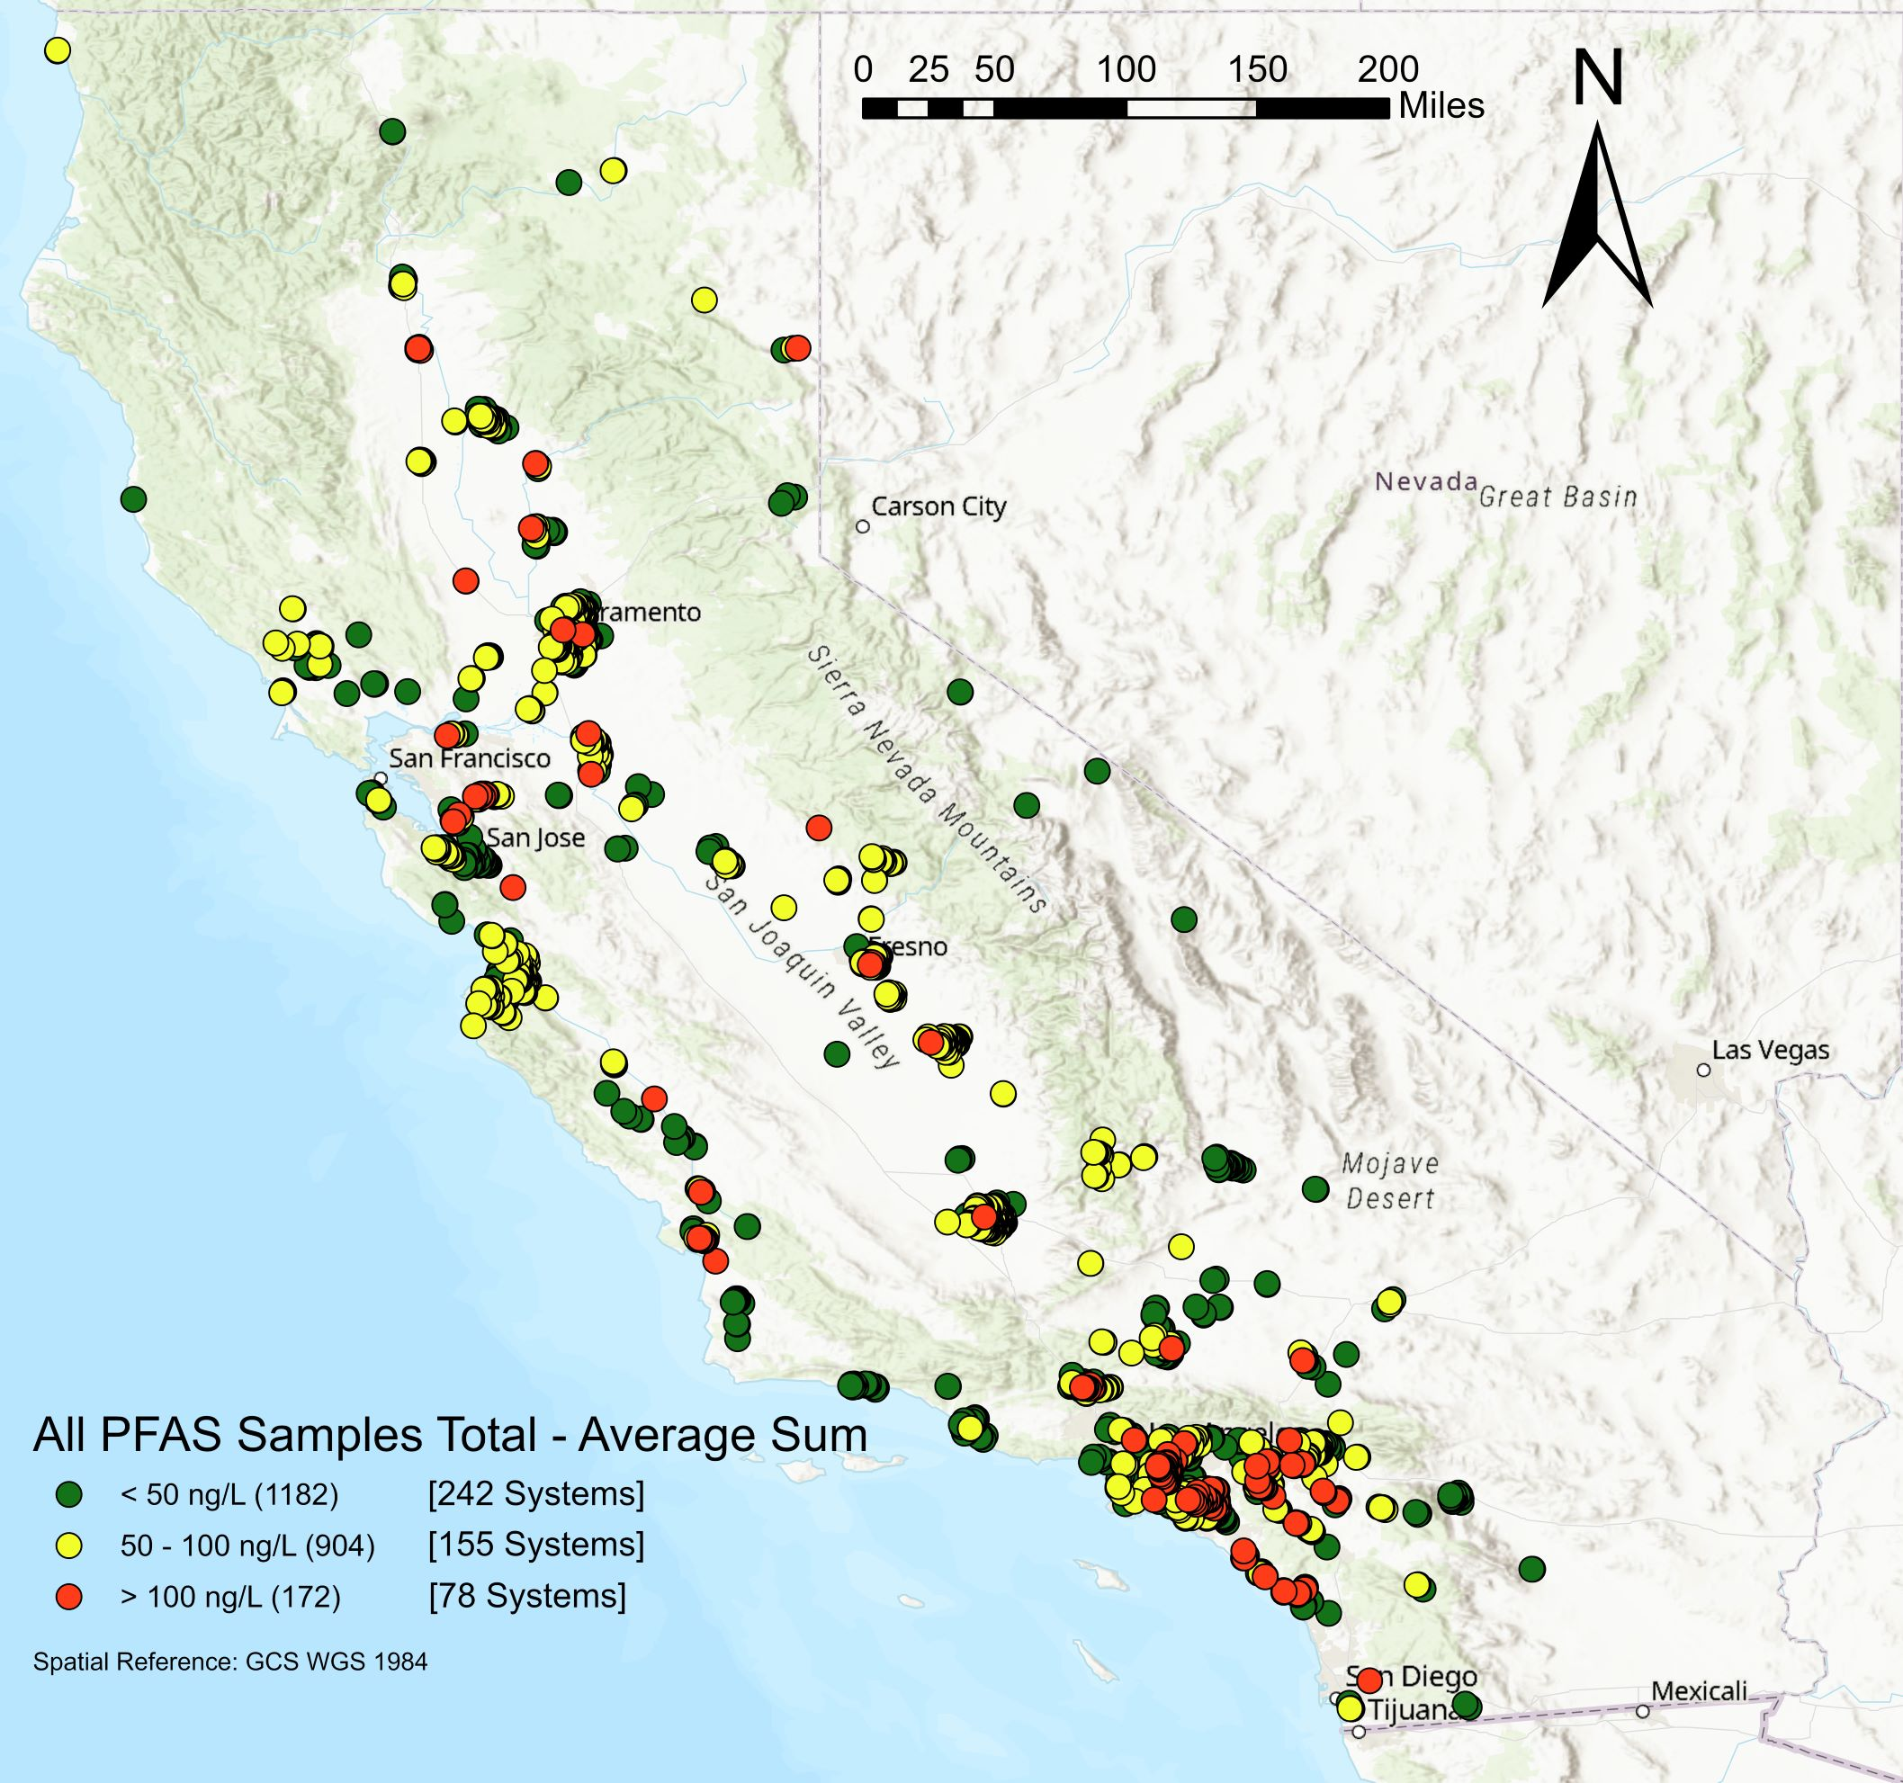
Method 537.1 Cumulative PFAS provides a broader understanding of Occurrence in Drinking Water
Data downloaded in February 2022
Total PFAS sums based on EPA Method 537.1 (18 analytes) – Averages based on the PFAS sums for the last 4 quarters
April 2022
13

Slide 14
Upcoming State and EPA actions…
Non-Drinking Water
Final Release of EPA Method 1633
Draft Release of PFAS Total Organofluorine (TOF) Method
UCMR5 - Small & Large Water System Sampling
Complete Statewide Source Investigations
2022
2023
2024
2025
Draft NPDES Monitoring Requirements for Wastewater/Stormwater Discharges & Guidance to add PFAS Monitoring
Wastewater Effluent Limitation Guidelines for Electroplating
MCL – PFOA/PFOS
Final Public Health Goal – PFOA/PFOS
Maximum Contaminant Level (MCL) - PFOA/PFOS
Issue Drinking Water Notification Level/Response Level - PFHxS
Possible Designation of PFOA/PFOS as Hazardous Substances
EPA
State Water Board
April 2022
14

Slide 15
More to come…
Industry Investigations
Drinking Water
Assessment
Assess PFAS at surface water intakes along several major rivers in CA
Expand PFAS assessment monitoring in Stream Pollution Trends Monitoring Program (SPoT) and Surface Water Ambient Monitoring Program (SWAMP)
Determine unknown PFAS chemicals using non-target analysis
Monitoring
Incorporate PFAS monitoring requirements into permits
Re-Issue Orders to Public Water Systems for EPA Method 533
Incorporate EPA’s PFAS monitoring requirements into NPDES permits
Issue New Notification Levels and Response Levels, as necessary
Treatment
Ensure pretreatment program compliance w/EPA’s PFAS Effluent Limitations Guidelines and/or other PFAS discharge requirements
Continue issuing new water treatment permits to public water systems for PFAS removal
April 2022
15

Slide 16
California Coordinating Agencies
California Air Resources Control Board
California Department of Public Health
California Water Boards
CalRecycle
Department of Toxic Substances Control – Safer Consumer Products
Office of Environmental Health Hazard Assessment
California Department of Pesticides Regulation
April 2022
16

Slide 17
More information available at…
Water Board’s PFAS Website: www.waterboards.ca.gov/pfas/
Division of Drinking Water PFOA/PFOS website: www.waterboards.ca.gov/drinking_water/certlic/drinkingwater/PFOA_PFOS.html
Division of Financial Assistance PFAS Funding website: https://www.waterboards.ca.gov/water_issues/programs/grants_loans/pfas.html
Email: PFAS@waterboards.ca.gov
Subscribe to Receive Notifications: https://www.waterboards.ca.gov/resources/email_subscriptions/swrcb_subscribe.htm
Instagram
@ca.water.boards
Twitter @CaWaterBoards
Facebook
California State Water Resources Control Board
YouTube
State Water Resources Control Board
April 2022
17

